Slide 1

Exploratory Data Analysis
G2M Case Study
16th May 2024

Slide 2

Agenda
Executive Summary
Problem Statement
Approach
EDA
EDA Summary
Recommendations

Slide 3
Executive Summary
Objective.
Investigating the performance of two Cab companies in the US and derive actionable insights for an investment by XYZ Private Firm.
Data Overview.
The data has 359392 datapoints with 12 features all interlinked within 4 datasets.
Key Findings.
There is a general preference of Cab service throughout, with a handful of outliers only.
The profit for each ride is based on the total calculated cost of the ride and the price charged by each company.
Majority of the dataset is based on active users of the service and not overall number of people.

Slide 4

Problem Statement & Approach
Problem Statement
To perform Exploratory Data Analysis (EDA) on Cab ride data in different states of the US. In order to predict which Cab company performed better over the course of 3 years (31/01/2016 - 31/12/2018), to determine which company is a better investment for XYZ Private Firm.
Approach
Understanding each individual dataset.
Find any outliers or anomalies.
Visualizing trends in data for better understanding.
Finding profit for both companies.
Recommendations for investment.
Cab_Data.csv
Customer_ID.csv
Final DataFrame
Transaction_ID.csv
City.csv

Slide 5
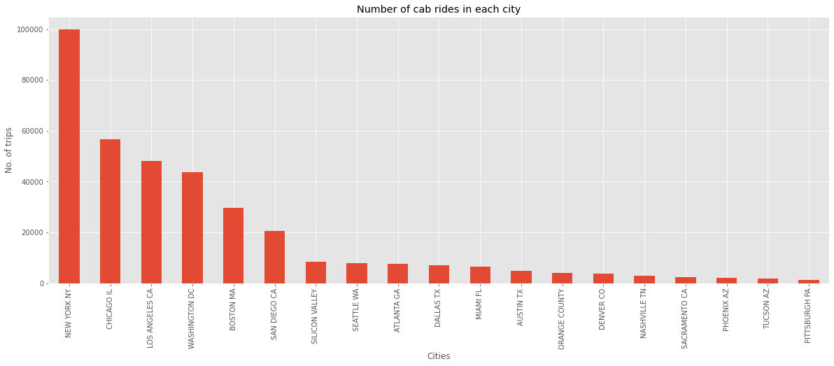
Largest Markets
The data shows biggest market in the city of New York, almost double that of Chicago IL which sits in 2nd place.
The cities with the highest users tend to be the ones which are the most popular cities in the country.
The city of New York has nearly 100,000 rides while cities like Pittsburgh PA, Tuscon AZ have less than 2,000 rides.

Slide 6
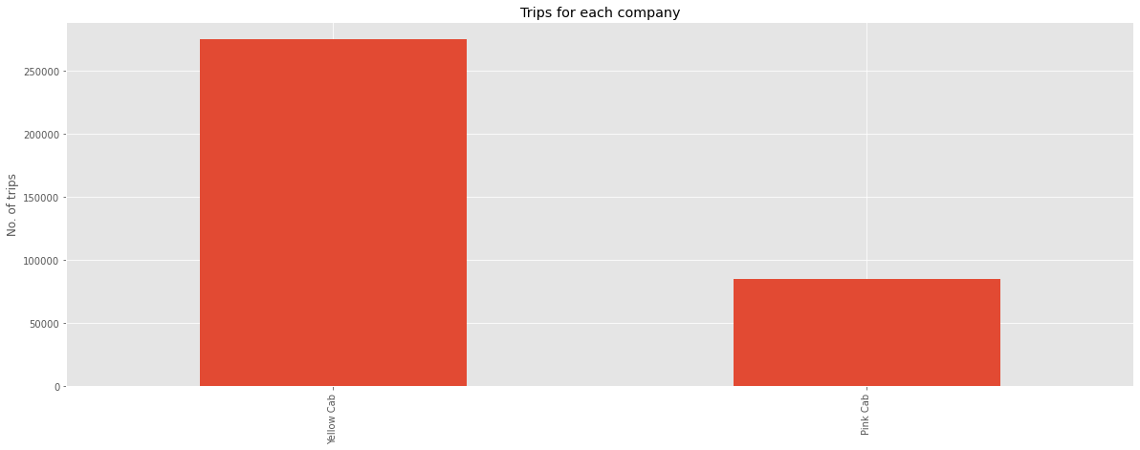
Market Share
The Yellow Cab company has the majority market share in the industry with more than 3 times the amount of rides than the Pink Cab company.
The Pink Cab company has a total number of rides which is under 6 figures (84,711 rides) while the Yellow cab company is significantly in the 6 figures (274,681 rides)

Slide 7
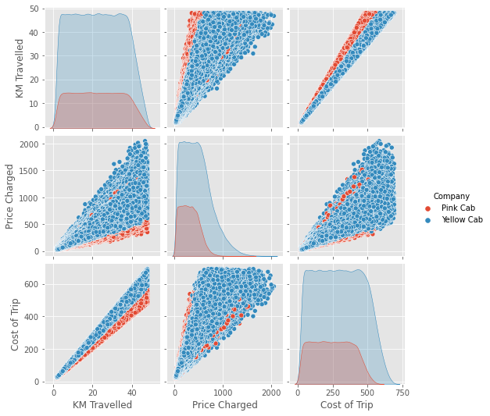
Analysis of Trips
Yellow Cab trips linearly cost more than the Pink Cab trips but the Price charged is exponentially more.
The Pink Cab looks like they occasionally charge similar to the Yellow Cab while their trip cost is lower.
People don’t seem to mind the higher prices of the Yellow Cab and use it more often.

Slide 8
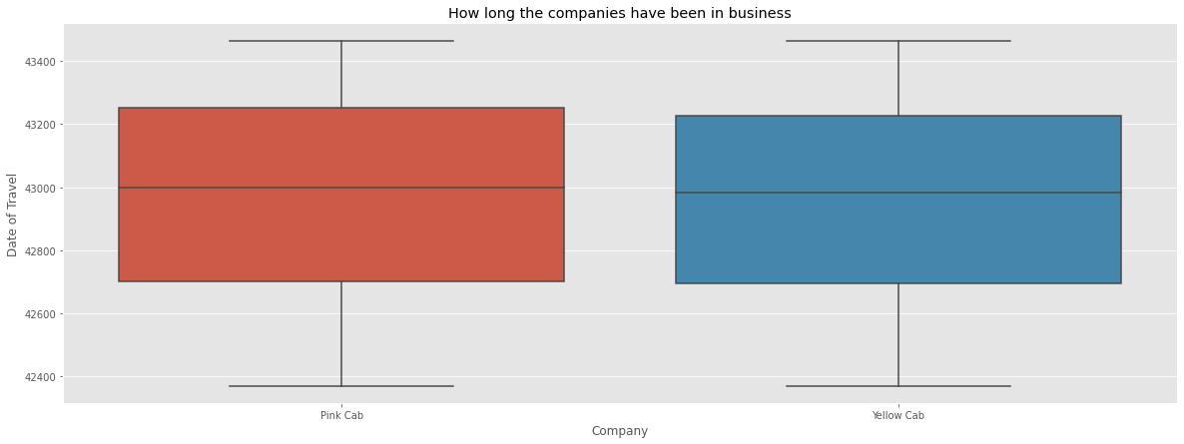
Time in business.
Both companies were in business for the same amount of time with consistent rides over the entire period.
The only differentiating factor seems to be the quantity of rides.

Slide 9
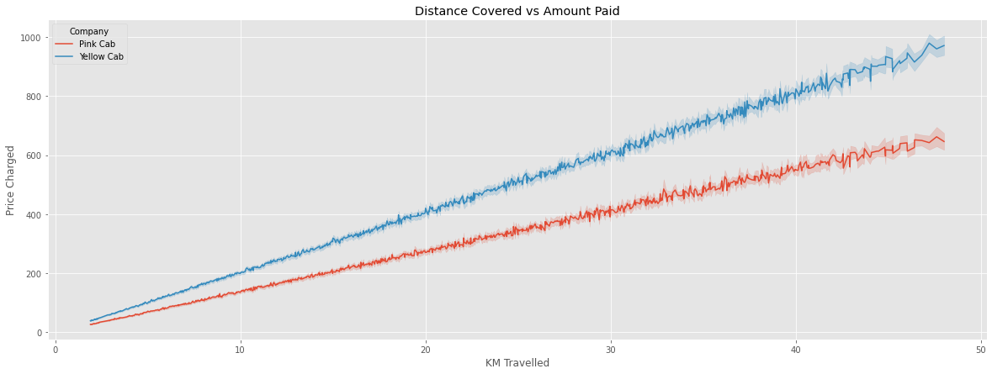
Price difference
The Yellow Cab, on average charges more than the Pink Cab for the same distance of trips.
Yet overall preference is towards the Yellow Cab.

Slide 10
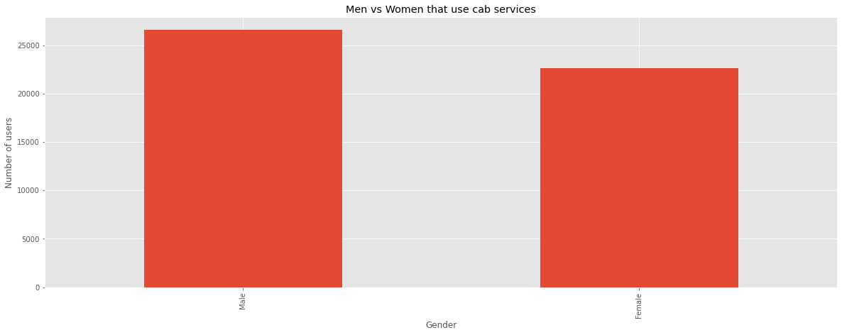
Gender demographic
There doesn’t seem to be a significant difference in the number of men and women that use cab services.
Men make up 26,562 of users.
Women make up 22,609 of users.

Slide 11
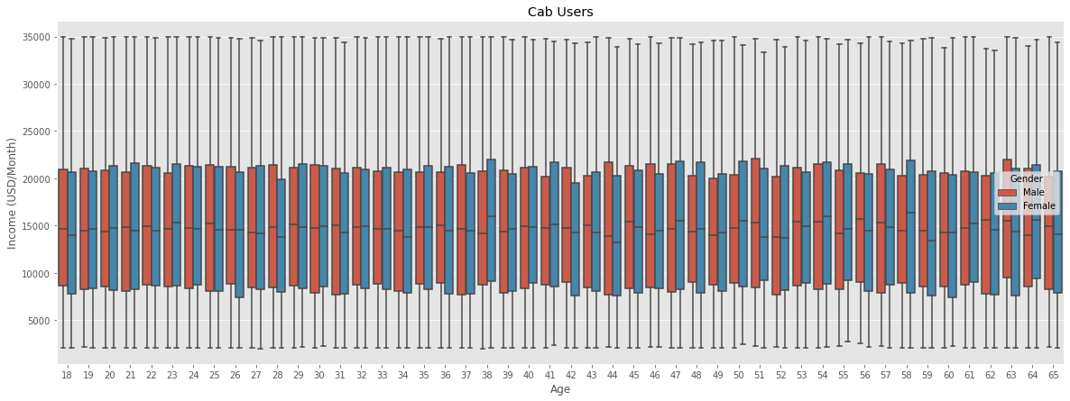
Age/Income demographic
The age of users also doesn’t seem to play a role in men vs women using the services.
Men & Women of all age ranges use the services.
The income also doesn’t seem to play a significant role.
People earning around 2,000/m and people earning around 35,000/m all use the service.

Slide 12
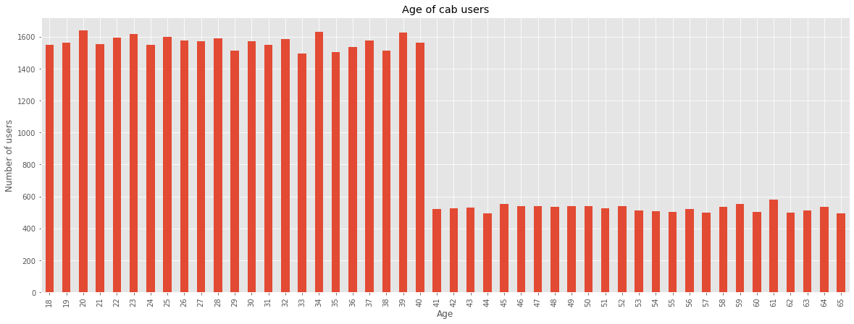
Number of users by age
Over the age range of 18-65, users tend to not use cab services drastically as soon as they hit 40 years of age.
18-39 aged users are almost triple (averaging 1500 users) than 40-65 aged users (averaging 500 users).

Slide 13
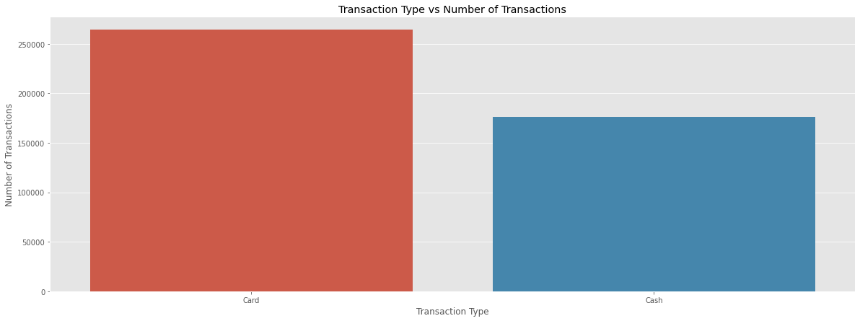
Transaction type
Majority of transactions take place via card, but there is still a large number of cash transactions.
Card payments make up 263,991 rides.
Cash payments make up 176,107 rides.
Cash is around 2/3 of Card payments.

Slide 14
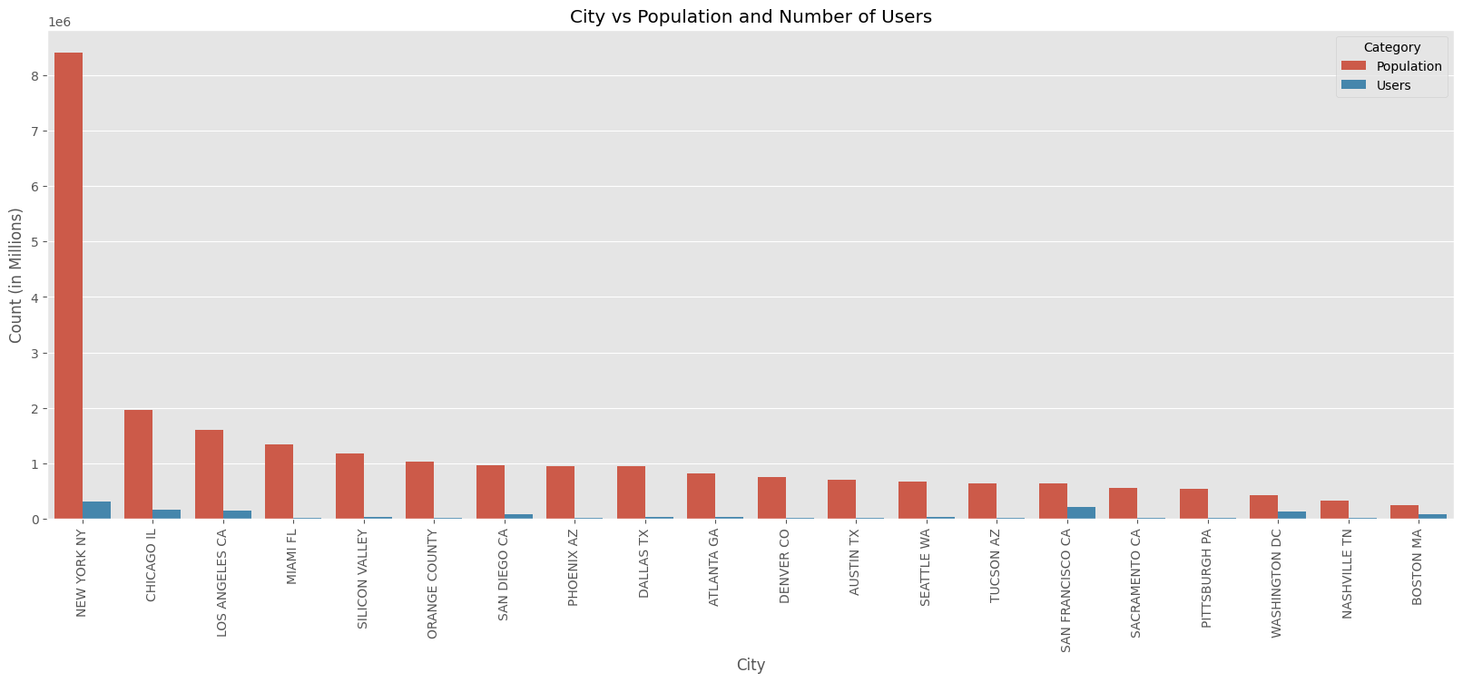
Population vs Users
An extremely small amount of people in every city use cab services.
Only San Francisco CA and Washington DC seem to have a significantly higher number of users compared to the population of the city.

Slide 15
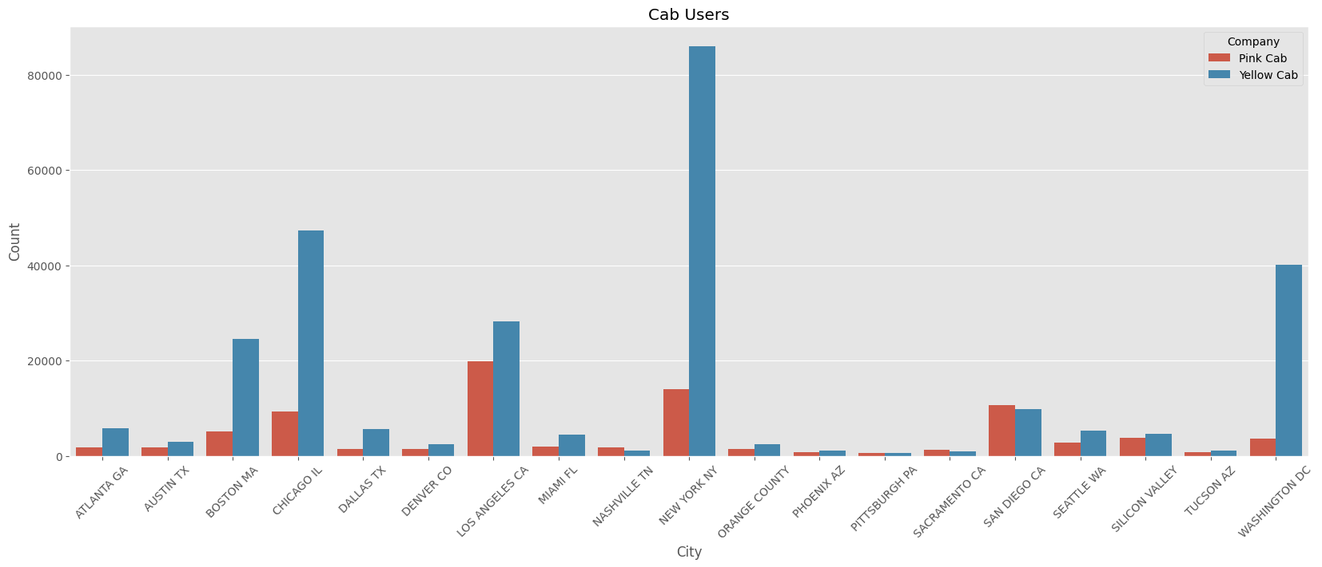
Users/Company in each city
Yellow cab is preferred in every city except:
Nashville TN, Sacramento CA, San Diego CA.
Pittsburgh PA is about the same.

Slide 16
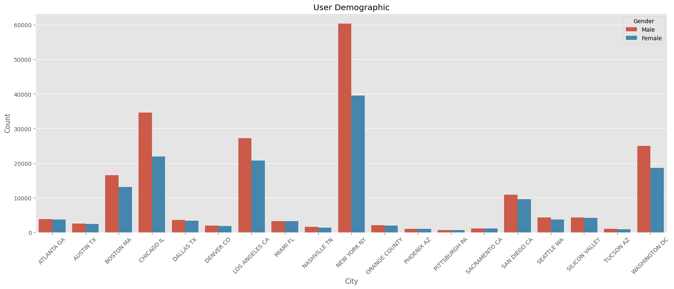
Male and Female users in each city
We can see that the gender also does not play a role in which cab company is preferred in the cities.

Slide 17
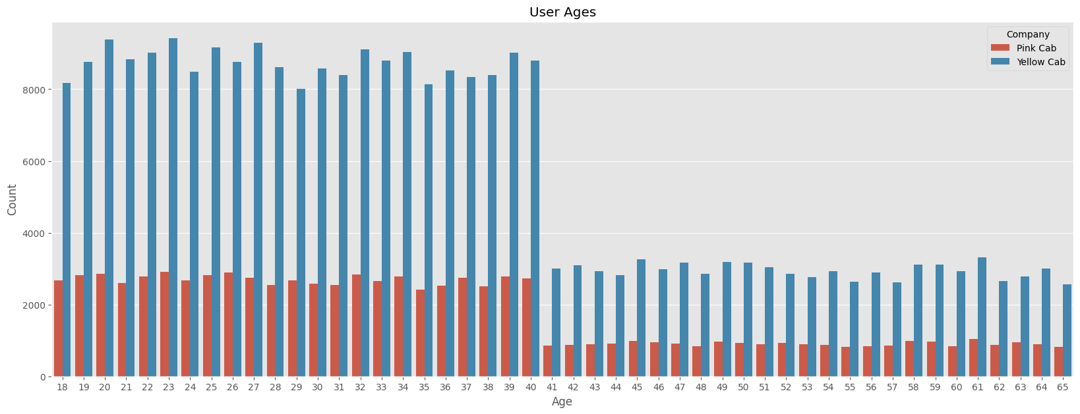
Age/Company in each city
There is also no significant difference in the different age groups that use the service, except for the fact that after the age of 40 people tend to use cab services less frequently. This is in line with the overall user concensus.

Slide 18
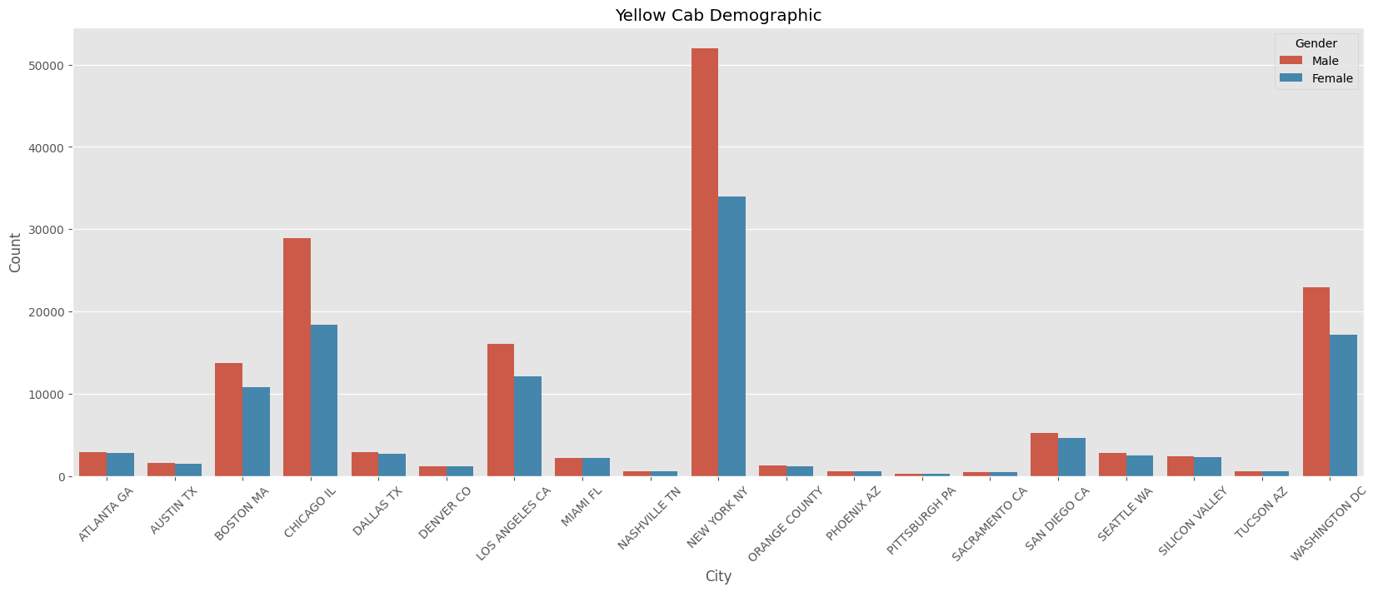
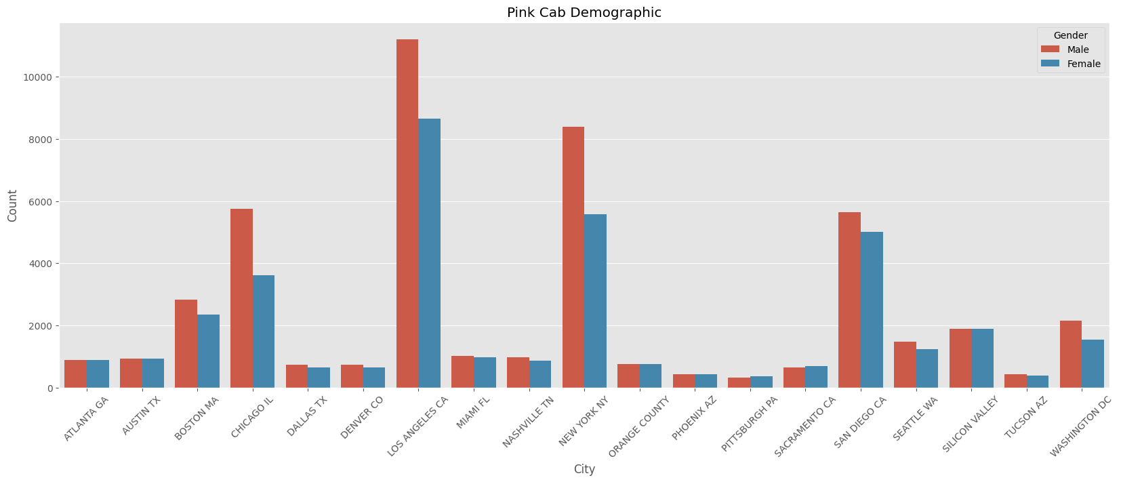
Gender comparison / company
There is a spread of user choice in each city as we can see.
NYC is the most popular for Yellow Cabs
Los Angeles CA, San Diego CA and, Chicago IL have more users of the Pink Cab.

Slide 19
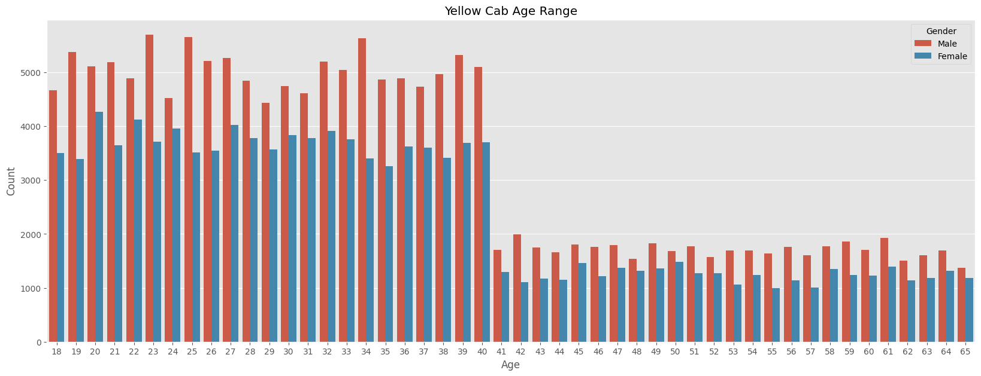
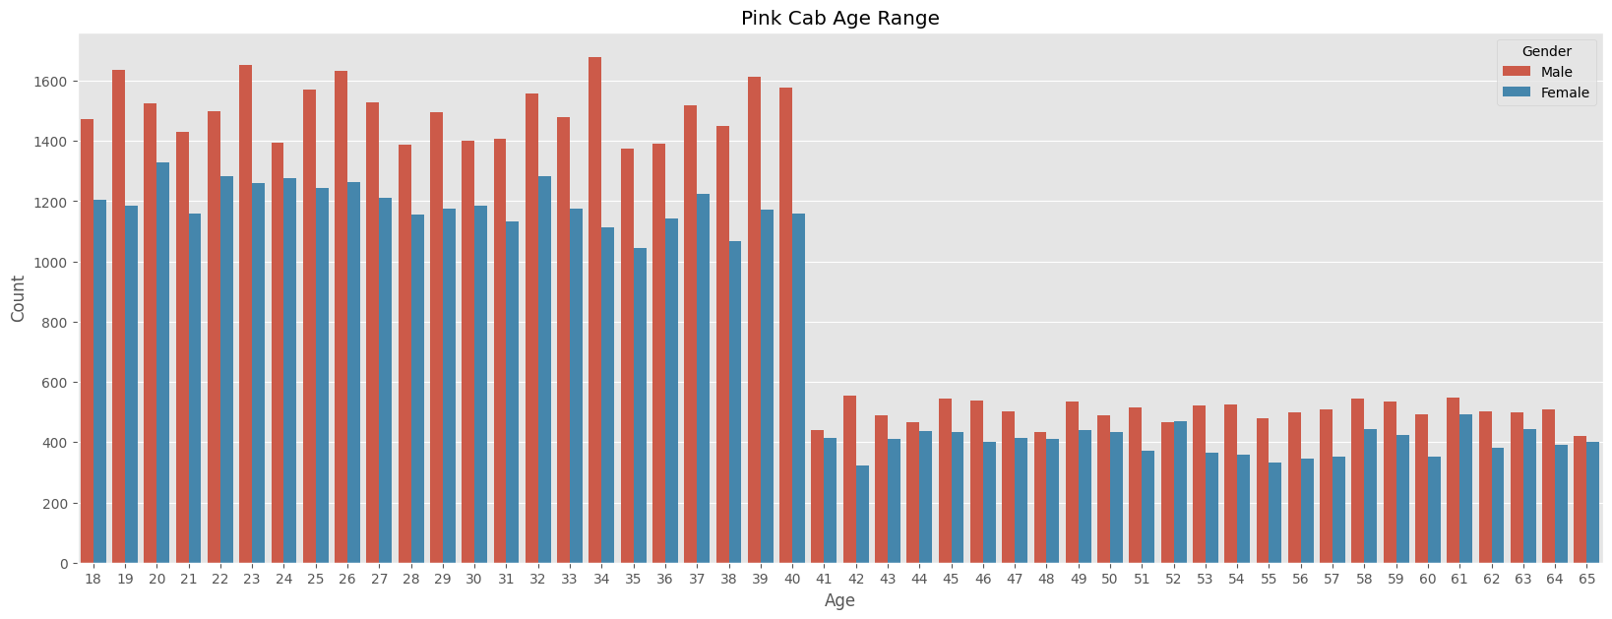
Age comparison / company
The age range of the users however, does not vary for either company, and is in line with overall users/age-group.

Slide 20
Profits
 | KM Travelled | Price Charged | Cost of Trip | Age | Income (USD/Month) | Profits
count | 274681
mean | 22.57 | 458.18 | 297.92 | 35.34 | 15045.67 | 160.26
min | 1.9 | 20.73 | 22.8 | 18 | 2000 | -176.93
max | 48 | 2048 | 691.2 | 65 | 34996 | 1464
 | KM Travelled | Price Charged | Cost of Trip | Age | Income (USD/Month) | Profits
count | 84711
mean | 22.56 | 310.8 | 248.2 | 35.32 | 15059.05 | 62.65
min | 1.9 | 15.6 | 19 | 18 | 2000 | -220.06
max | 48 | 1623.5 | 576 | 65 | 35000 | 1119.5
Accounting for all the trips conducted by each cab company for it’s users, the numbers verify our findings.
Yellow Cab makes almost 100$ more on average in profits while covering the same distances.
All other factors are almost identical suggesting that people would pay more for the Yellow Cab than use the Pink Cab.

Slide 21
Summary
Throughout the analysis we can see that, age, gender, income range do not play huge roles in user choice of a certain cab company.
The cities however do influence which cab company is more popular. (California in general prefers Pink Cab)
New York is the city with most cab rides and has the highest users of Yellow Cab.
Although Yellow Cab is generally more expensive than Pink Cab, users still (with the exception of CA and a few outlier cities) prefer Yellow Cab over Pink Cab.
Yellow Cab has more than 3 times the market share overall.
Yellow Cab produces more revenue because of the higher prices they can charge while maintaining customers.

Slide 22
Recommendations
On evaluation of the two companies on several factors, it is generally concluded that the Yellow Cab Company is better than the Pink Cab Company.
Yellow Cab is a better investment overall.
Pink Cab is better if investing only in California.
Age, Gender and, Income play no significant role in user preference and does not need any special attention.
Yellow Cab generates more profits and concurs less loss than Pink Cab.
RECOMMENDATION IS TO INVEST IN THE YELLOW CAB COMPANY

Slide 23
Thank You

